Slide 1
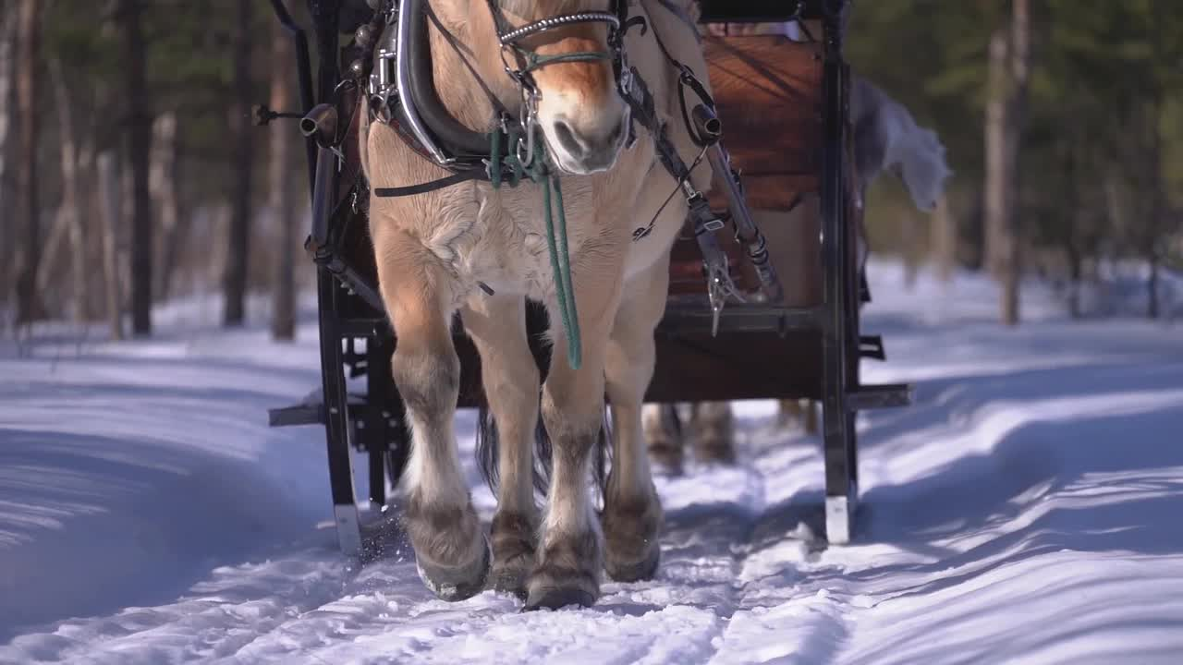
Flatmoen Natur
Jussi Halme, Elizaveta Krasovskaya, Magdalena Haag

Slide 2
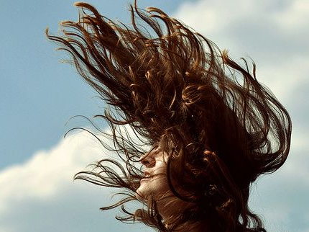

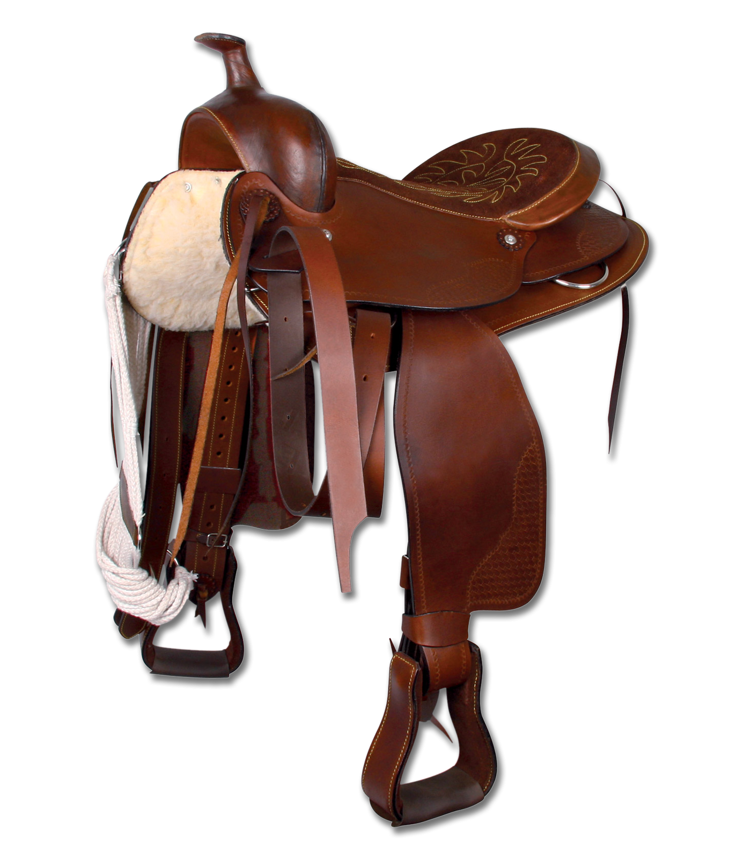
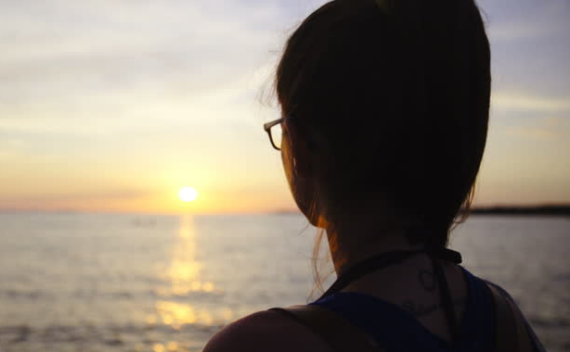
Do you want to free your spirits and explore your inner cowboy?
Have you ever dreamed of catching the wind while sitting in a saddle?
Do you admire beautiful views and the sense for freedom?

Slide 3
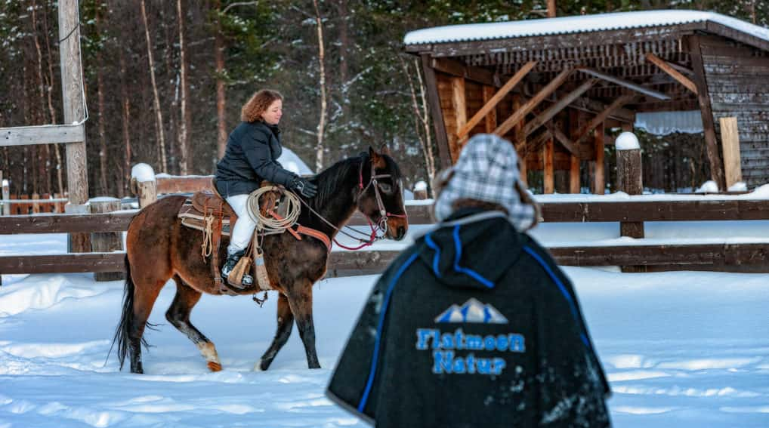
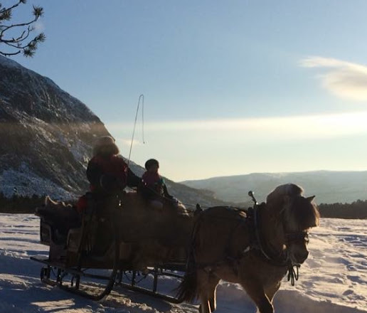
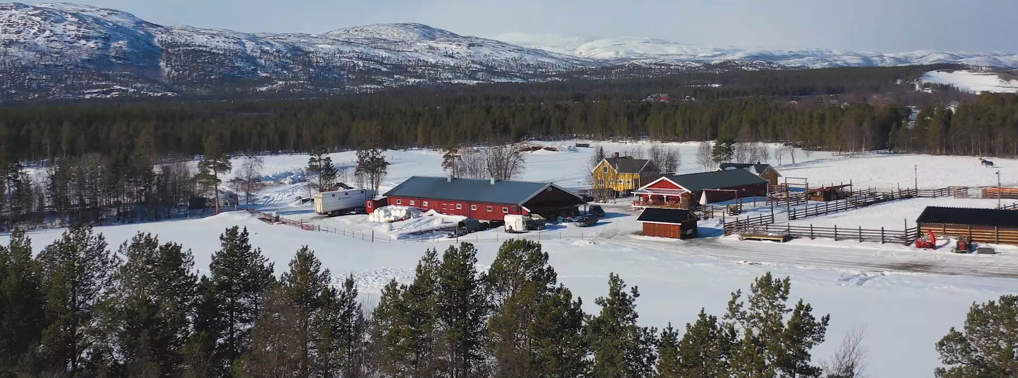
If YES, then we found the right place for you!

Slide 4
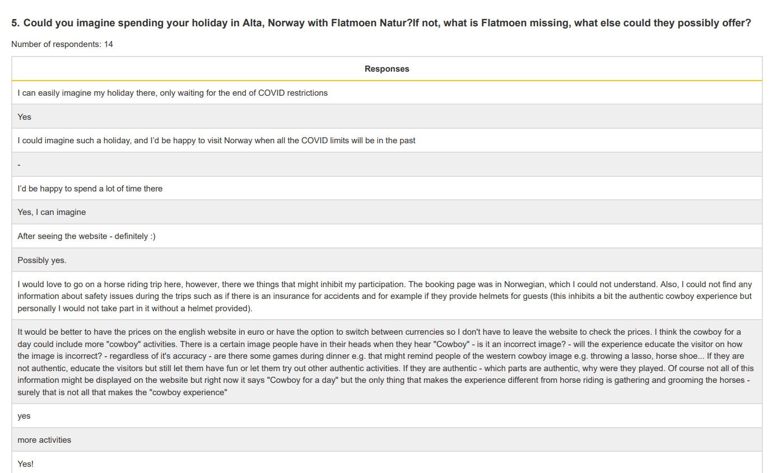
Survey results

Slide 5
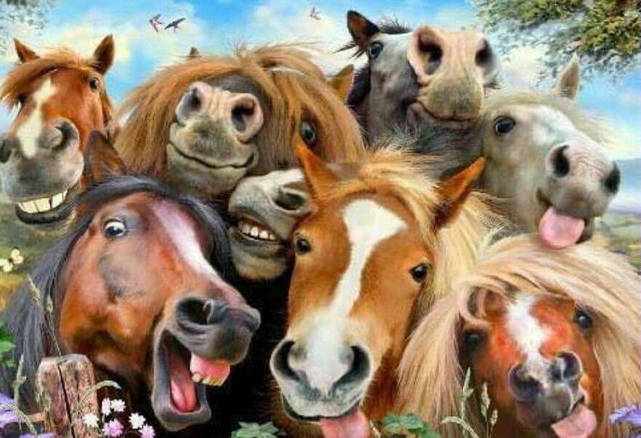
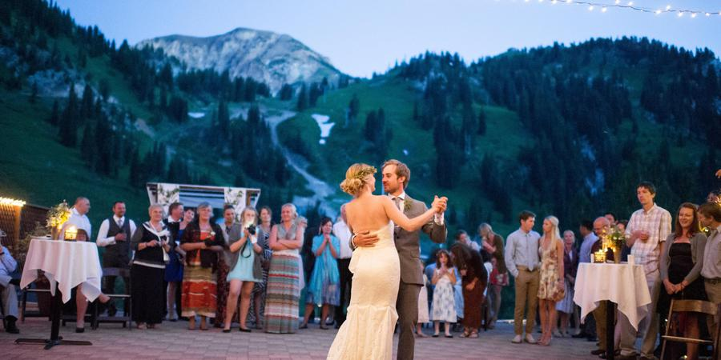
Special events
WEDDINGS
BIRTHDAYS

Slide 6
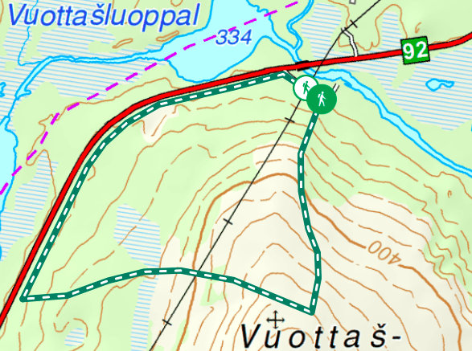
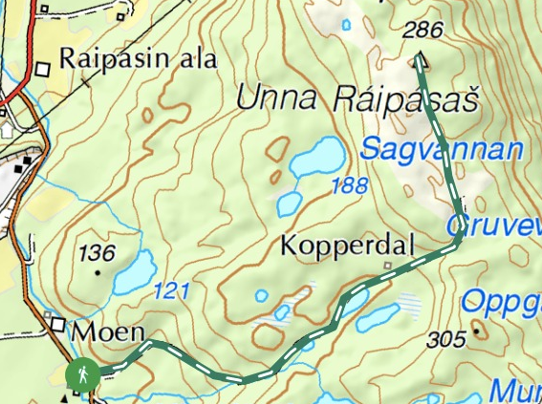
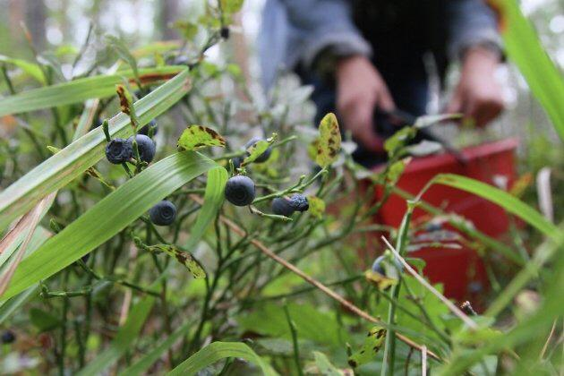
Route through Alta on horseback
Option 1
Option 2

Slide 7
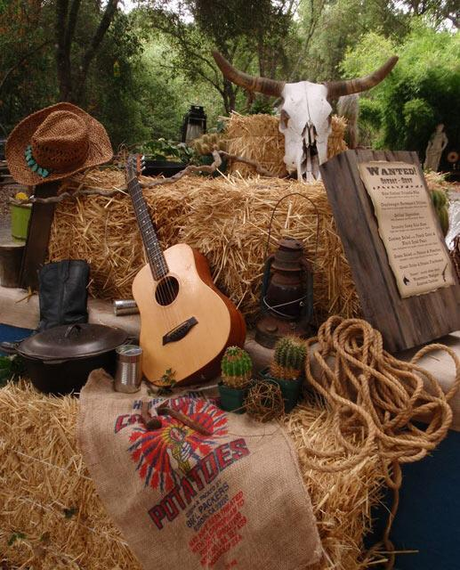
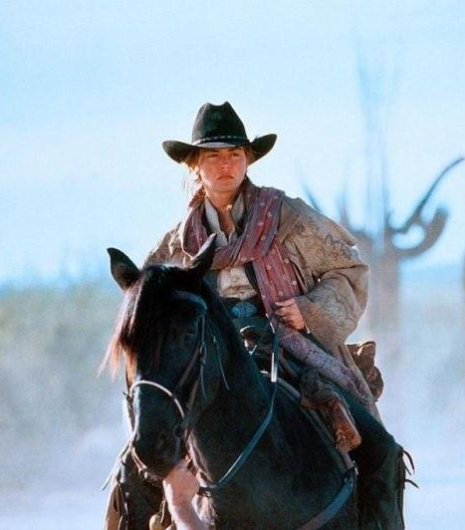
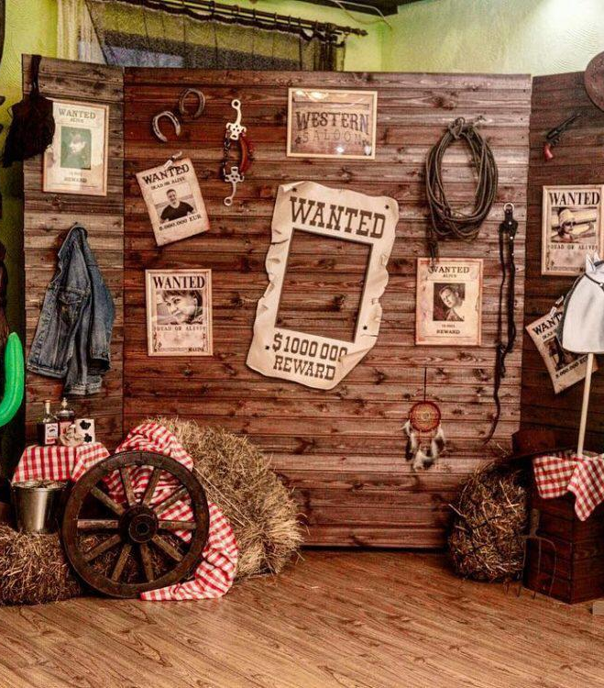
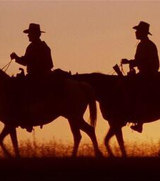
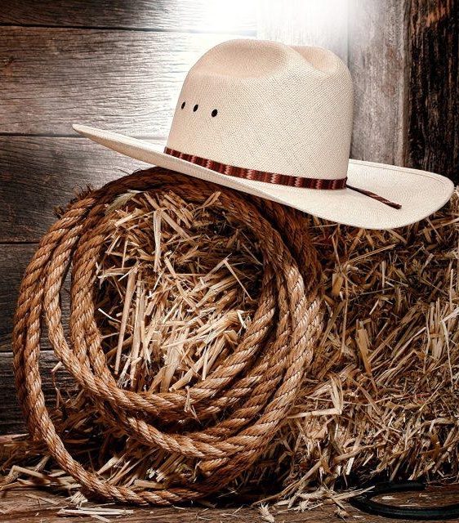
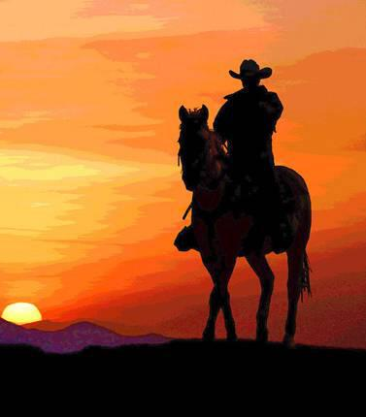
Creative solutions
Photos in Cowboy Style

Slide 8
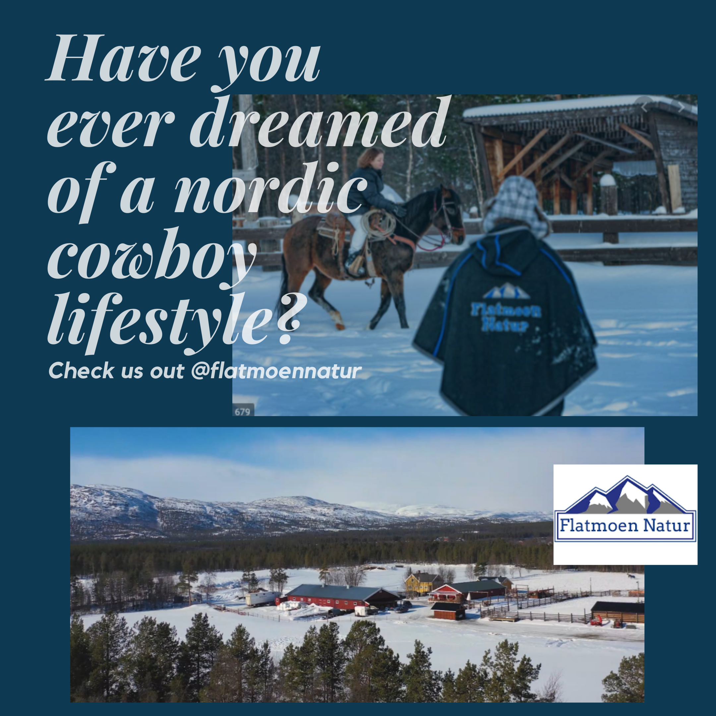


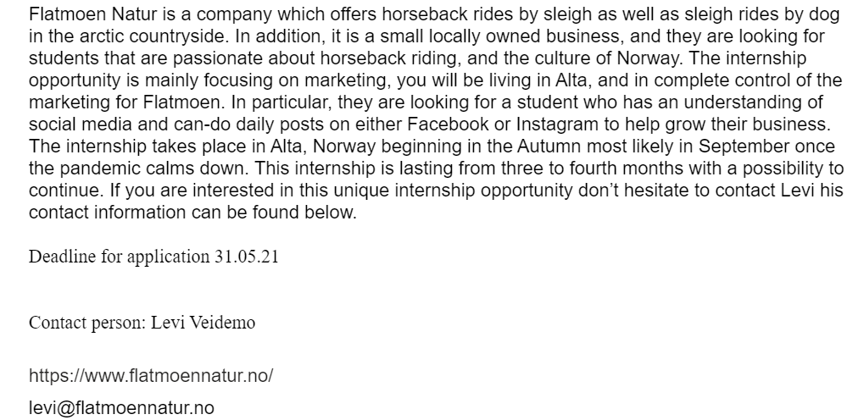
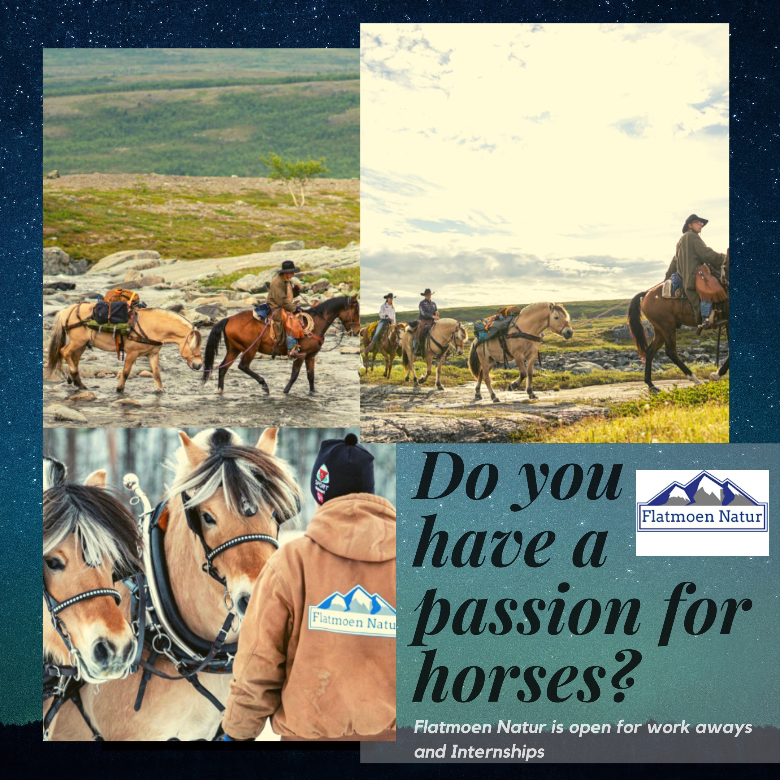
Social Media and Marketing Strategy
Intern to take care of Social Media channels

Slide 9
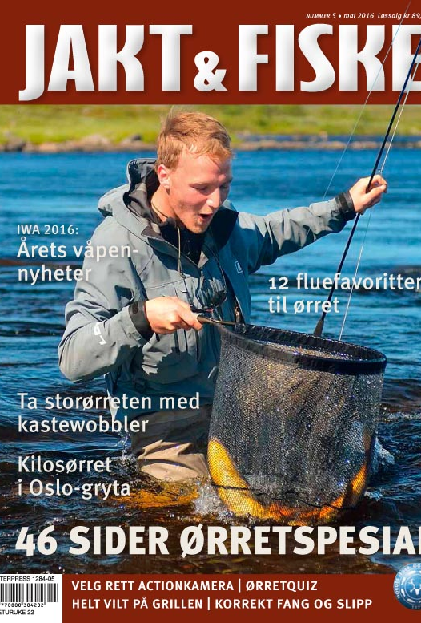

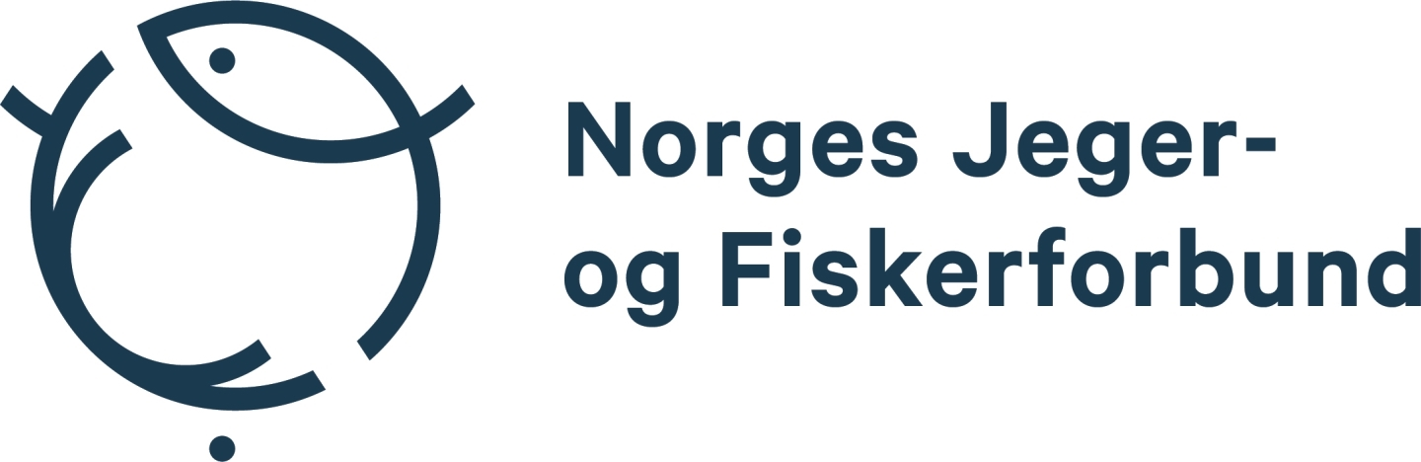
Partnerships
Magazine Jakt og Fiske
Norwegian Society for the Conservation of Nature (Norges Naturvernforbundet)
The Norwegian Association of Hunters and Anglers (Norges Jeger- og Fiskerforbund- NJFF)
Possible cooperation with agencies in Murmansk and Karelia for 20% discount after restrictions

Slide 10
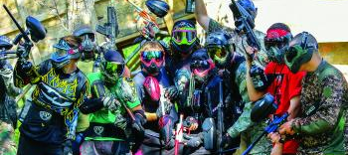
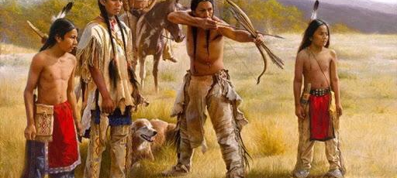
Possible long term strategy
Paintball
Shooting with bows and arrows in western style
Native American style events

Slide 11
Our journey
First Brainstorming
Rope park, kayaking, thematic events
Presenting ideas
Partnerships, viking themed events, social media marketing
Meeting the commissioners
→ adjustment of ideas
Contact week sessions, meeting commissioners again
Taking action (advertising possible training at Flatmoen Natur, contacting possible partners, etc)
Presenting updated ideas (focus on Marketing, partnerships, special events and a route)
Final Presentation (now)

Slide 12
What we have learned
creating a marketing strategy
analysing a market, supply and demand
inventing ideas for both our thoughts and customer’s needs
finding simple solutions for great results
creating contacts & business partnerships
working in a friendly, productive and cross -cultural team

Slide 13
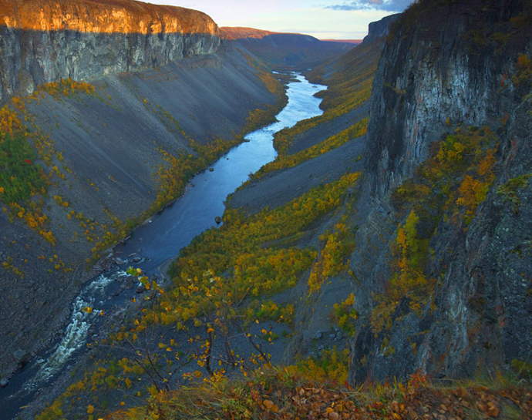
Thank you for listening!

