Slide 1

FINAL PRESENTATION:
to attract Russian High-End
made by team “HASVIK 1”:
Andrew Chuvak
Kseniia Ovcharenko
Katerina Moseeva

Slide 2
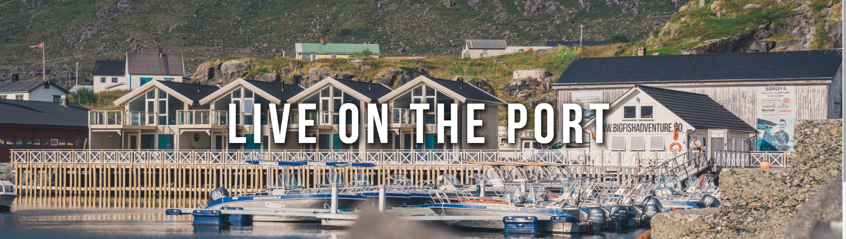
Big Fish Adventure
ecofishing
accommodation in houses and a hotel

Slide 3

Our ideas
1. Targeted advertising
2. Websites
3. YouTube channel
4. Promo tours

Slide 4
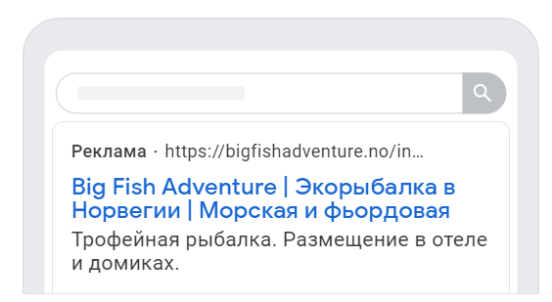
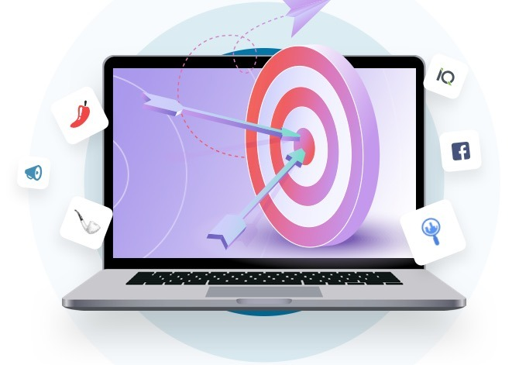
targeted advertising
Create Google account
Fill in the forms:
add keywords
specify geography
set a budget

Slide 5
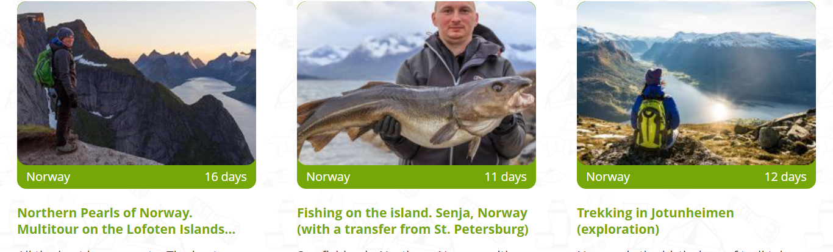
Placing information about tours on sites:
vpoxod.ru
Website traffic (per monts): 126 942
Websites

Slide 6
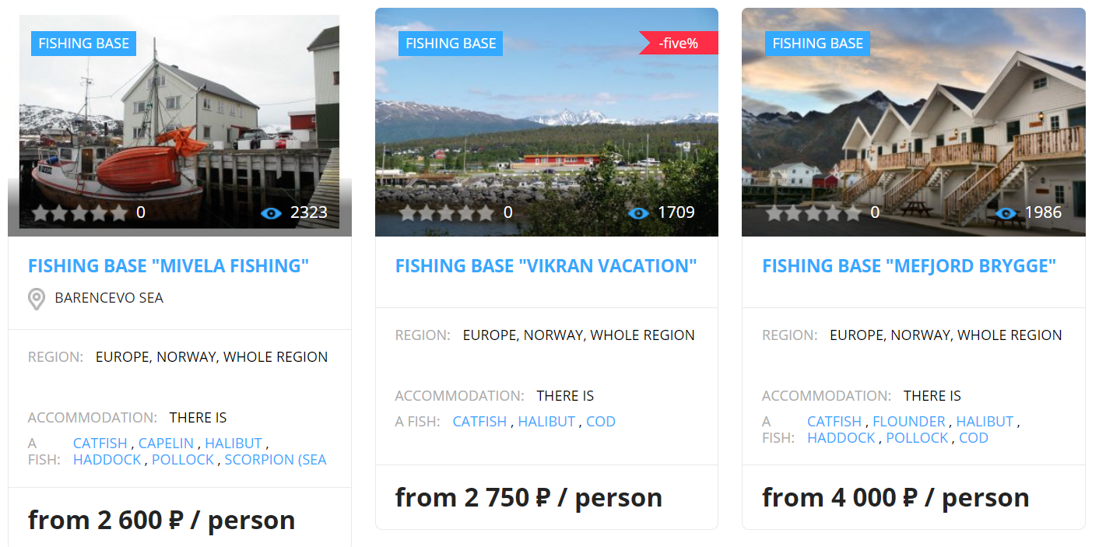
websites
eklev.ru
Placing information:
6,67$ (Standart)
20$ (Premium)
Website traffic (per monts): 11 232

Slide 7
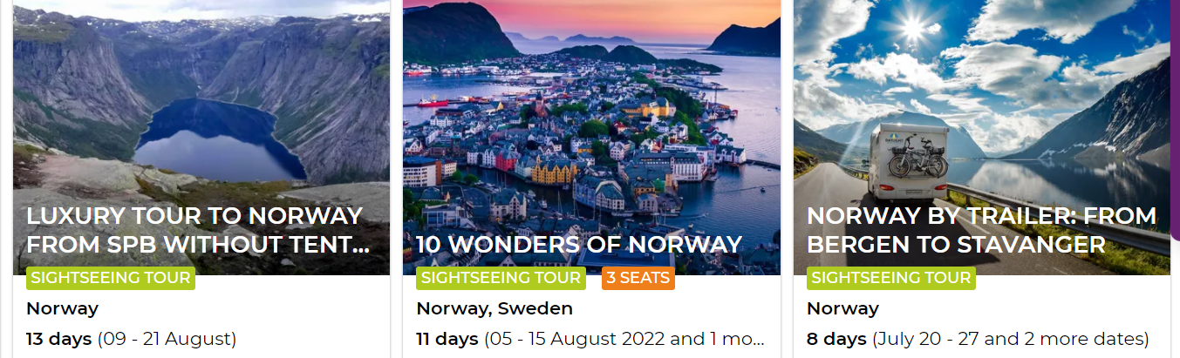
websites
youtravel.me
Placing information:
Service charge: 15%
Website traffic (per monts): 35 343

Slide 8
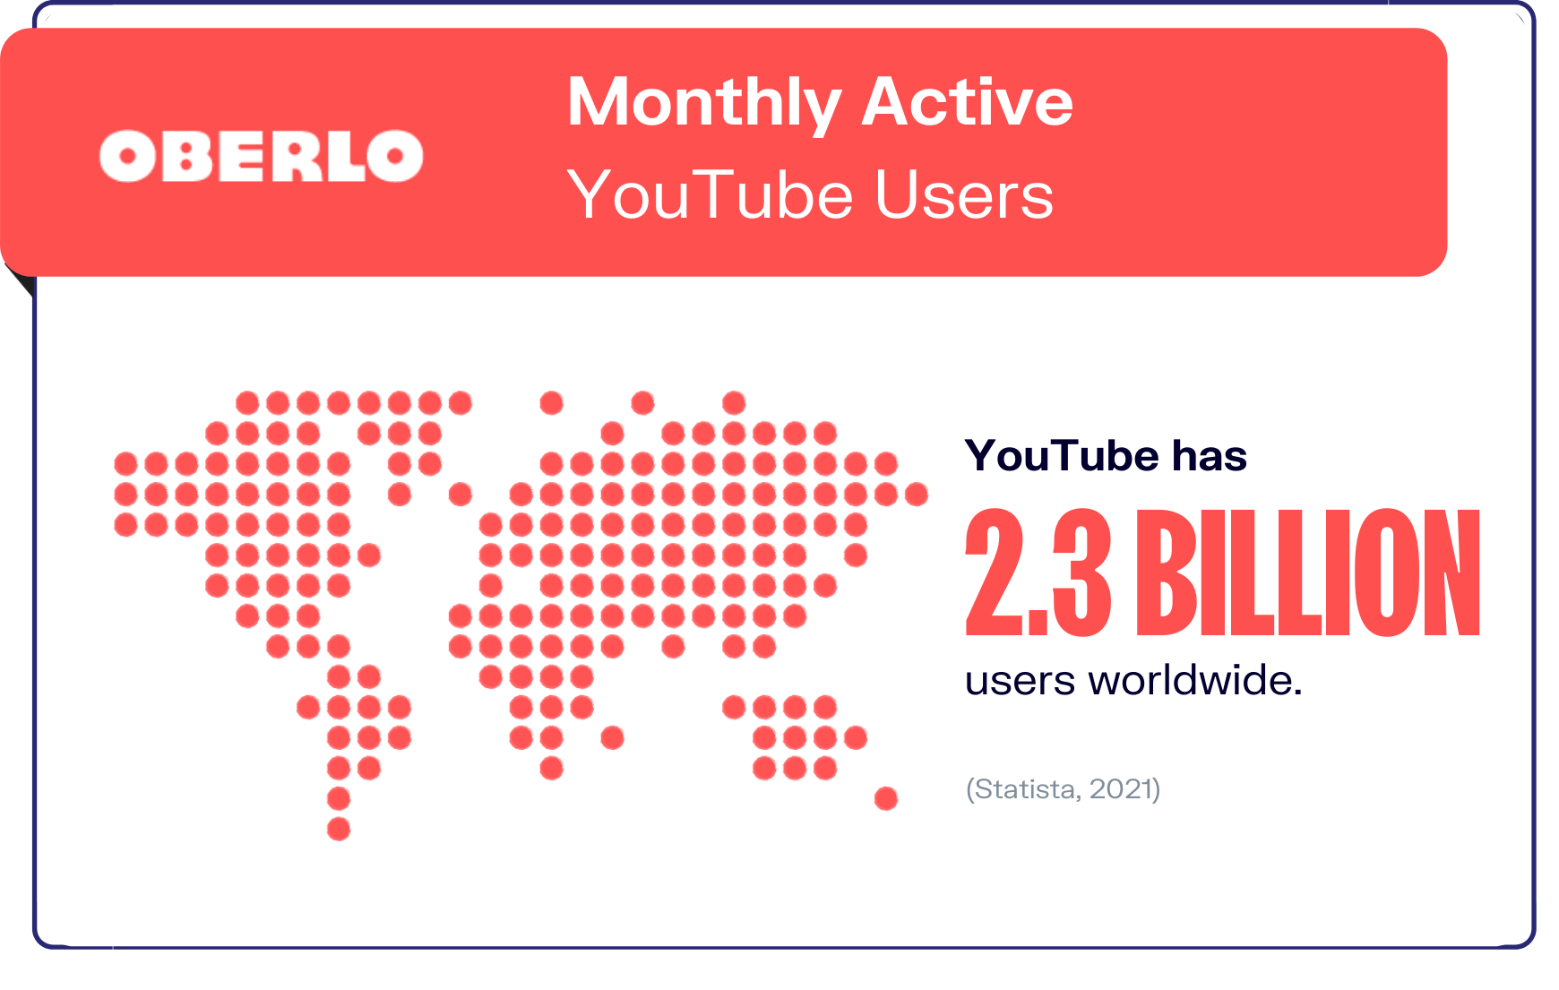
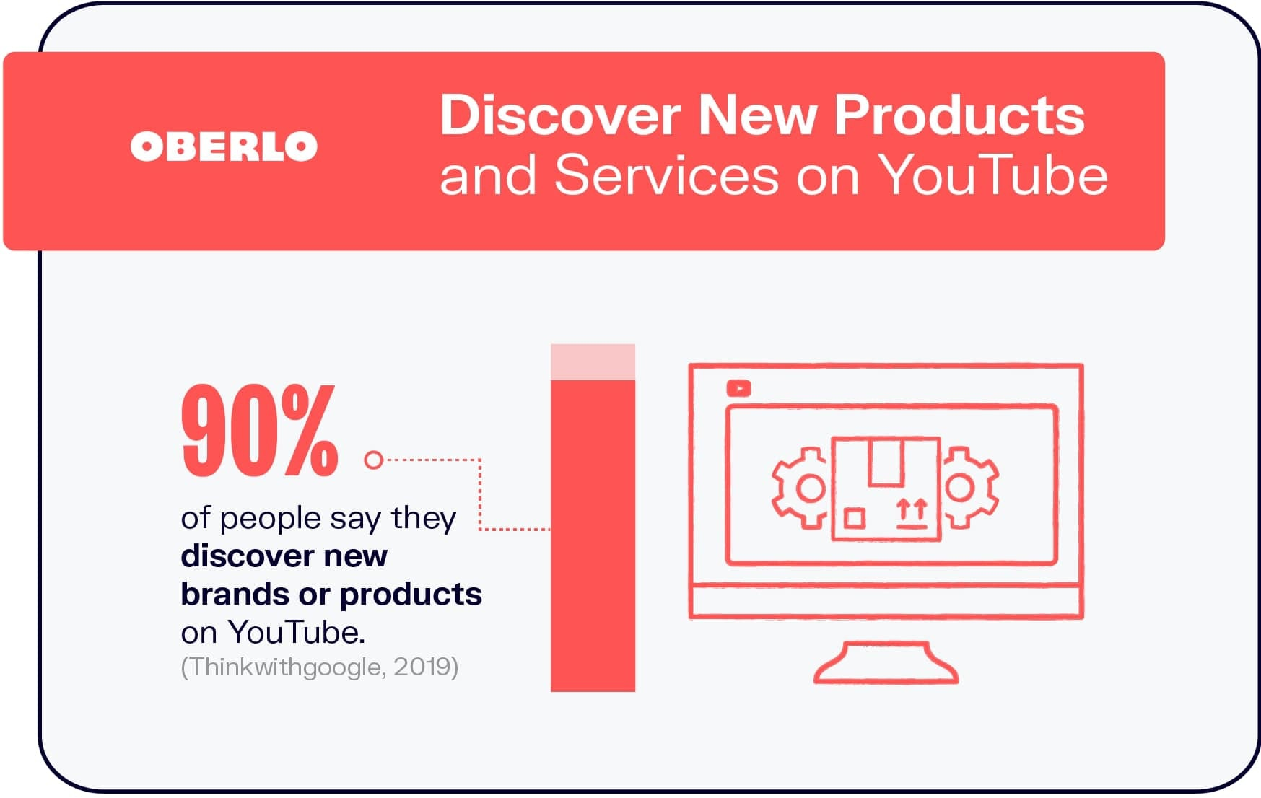
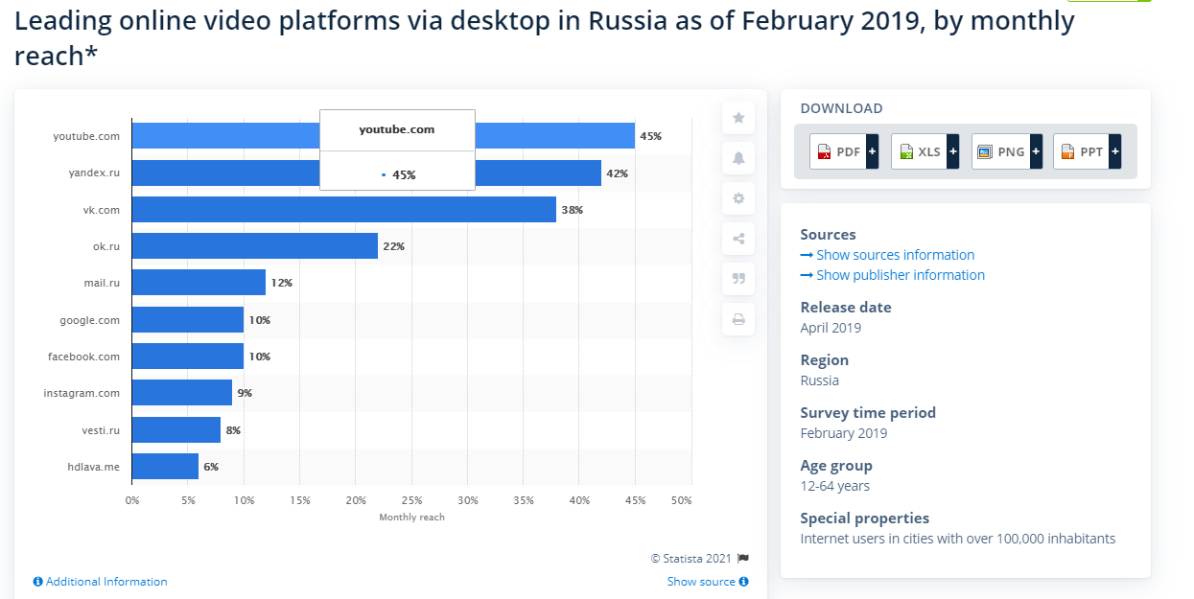


YouTube Channel
Statistic
Almost half of the YouTube audience in Russia consists of users aged 25-44 (48%). Male audience leads in almost all age segments.

Slide 9
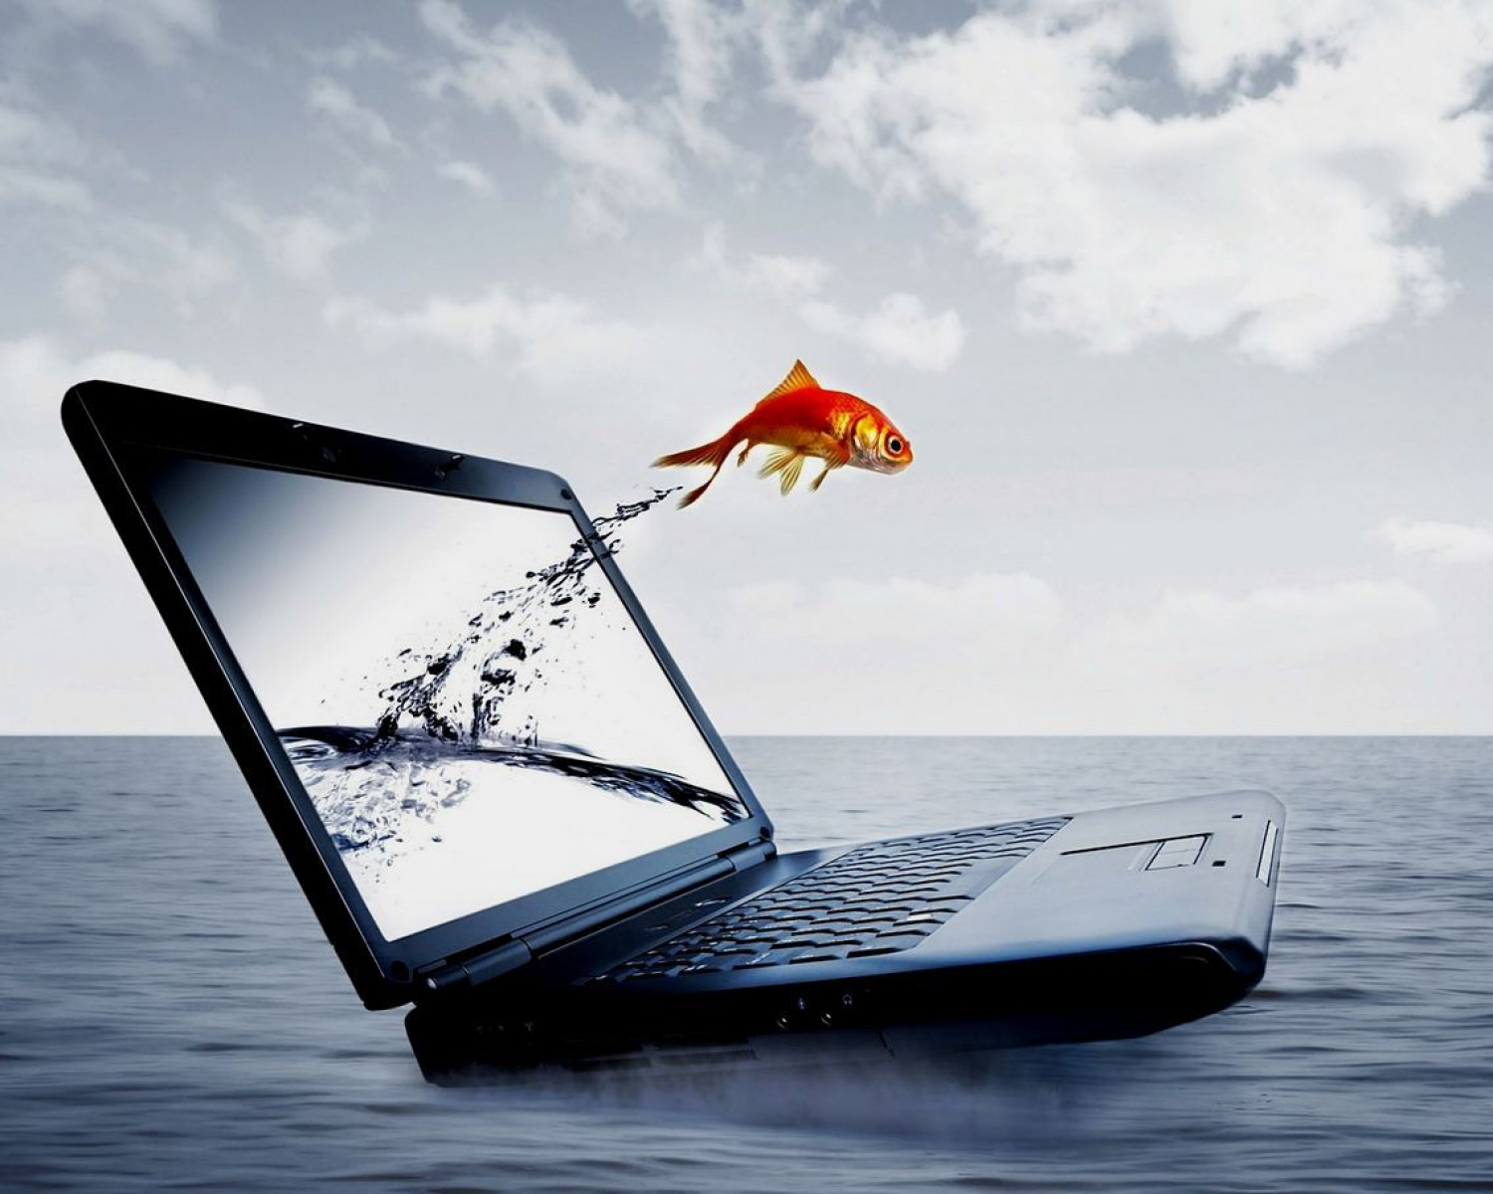
YouTube Channel
Benefits
Promotion of the company in the network in the direction of Russia
Assistance in providing customers with the benefits of the company
Attracting people interested in fishing abroad

Slide 10
YouTube Channel
Channel Description
Type of content:
Blog
Easier to create content, no need to mount much. Help the audience learn more about the adventures of the Big Fish. (reviews on models of fishing rods, boats and fish)
Interview
Interviews with BFA guests, where you can get feedback from visitors about the company's services, thereby improving the service
Humorous sketches
Small humorous videos about fishing to dilute the content. It can be released twice a month.
Educational Videos
They will help viewers not only determine the type of fish, but also how to make fishing more spectacular
Reality shows
A small show, for example, a fishing competition between visitors. Requires writing a script and good editing. Organize a show every two months or during a good bite

Slide 11
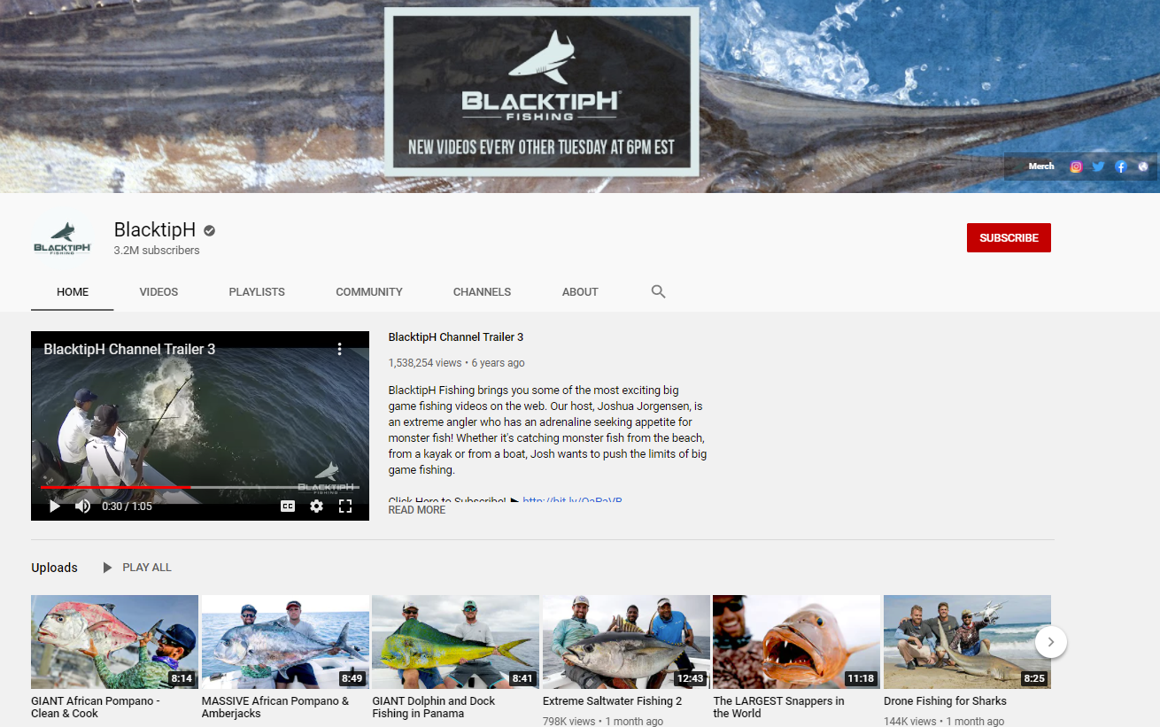
YouTube Channel
Example of the YouTube channel
We can see the video release schedule.
We will learn about the channel's theme from the trailer.
The description below each video helps you find out what it's about
Links to the website and social networks are posted
Videos are optimal in time

Slide 12
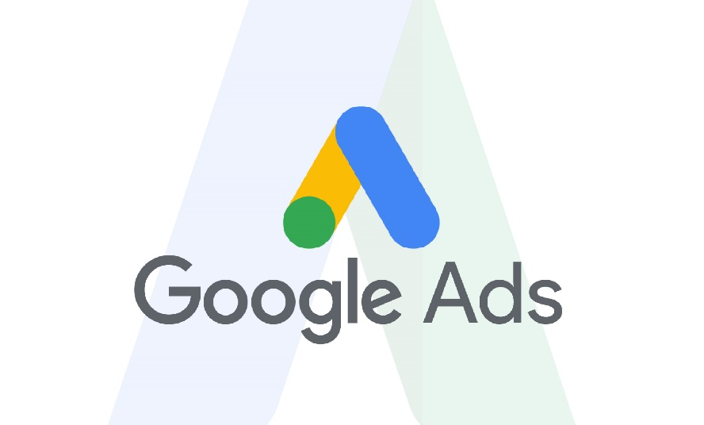


YouTube Channel
Channel promotion
FREE
Use of electronic video distribution.
Ask viewers to subscribe to the channel and put likes. You can also communicate with viewers in the comments.
Subscribe to popular channels on this topic, comment on their videos and discuss them.
Posting videos on websites or on social networks.
Cooperation on a free basis with other novice bloggers.
Release a variety of content.
Paid
• Advertising in Google ads (the price depends on the type of advertising)
• Use the site Target to advertise a channel of a certain audience (cost from 7,94 $)
• Paid collaboration with other bloggers

Slide 13

YouTube Channel
Risks
Channel promotion will spend more time and only after a few months it will be possible to find the right customers
Fishing abroad is not a popular topic in Russia, there cannot be many subscribers to the channel.
There are many channels about fishing, so you need to do something special to highlight the channel

Slide 14


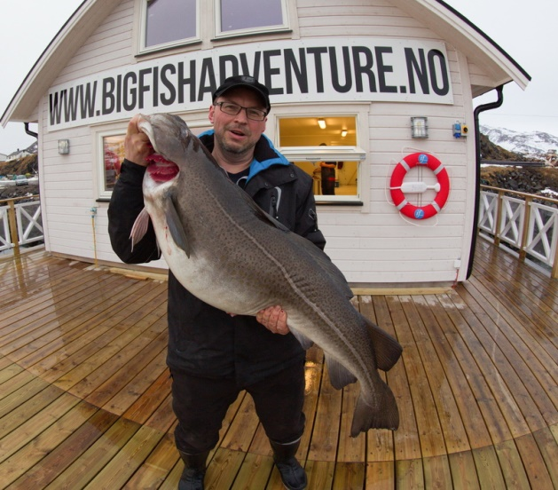
The program covers:
travel and accommodation expenses (some diet)
translation costs
visa costs
vital costs to your news story (conference fee or similar.)
The program does not cover:
Salary or project management costs
Investments in equipment
Camera rent
Other administrative costs

Slide 15
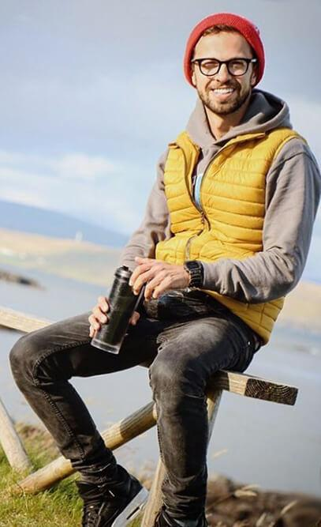



Anton Ptushkin
@ptuxerman
1,7 million followers
YouTube channel:
Anton Ptushkin
4.57 million followers

Slide 16
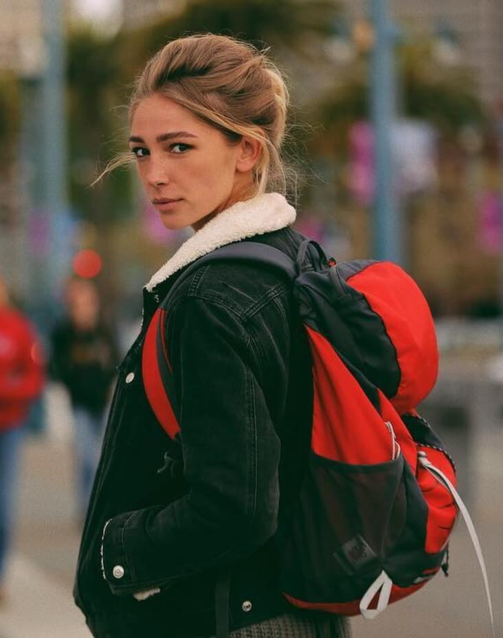
Anastasia Ivleeva
@_agentgirl_
18.7 million followers

Slide 17
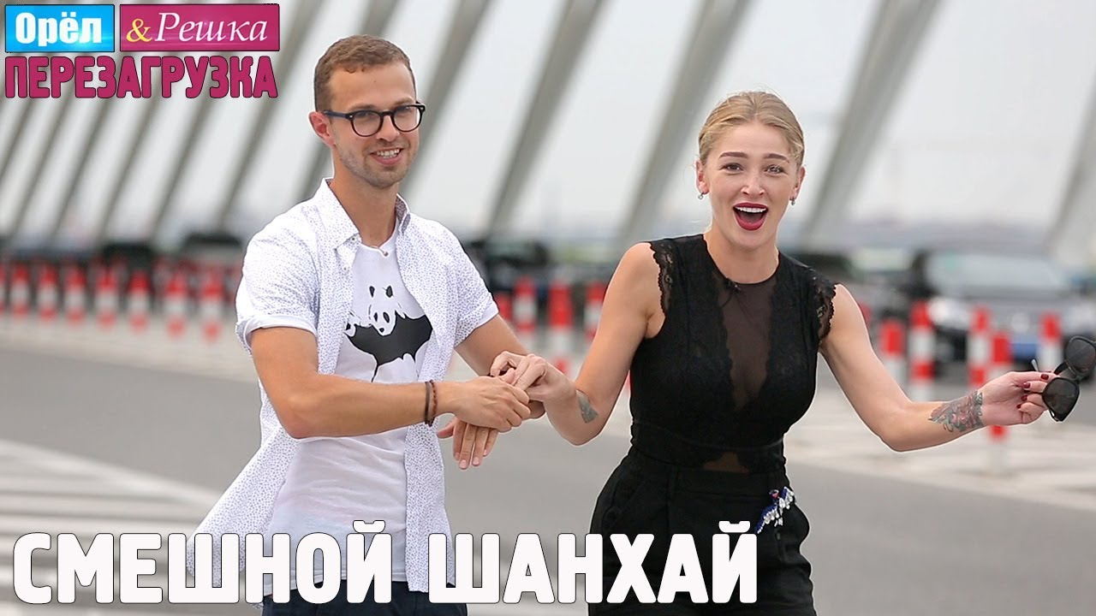

Slide 18
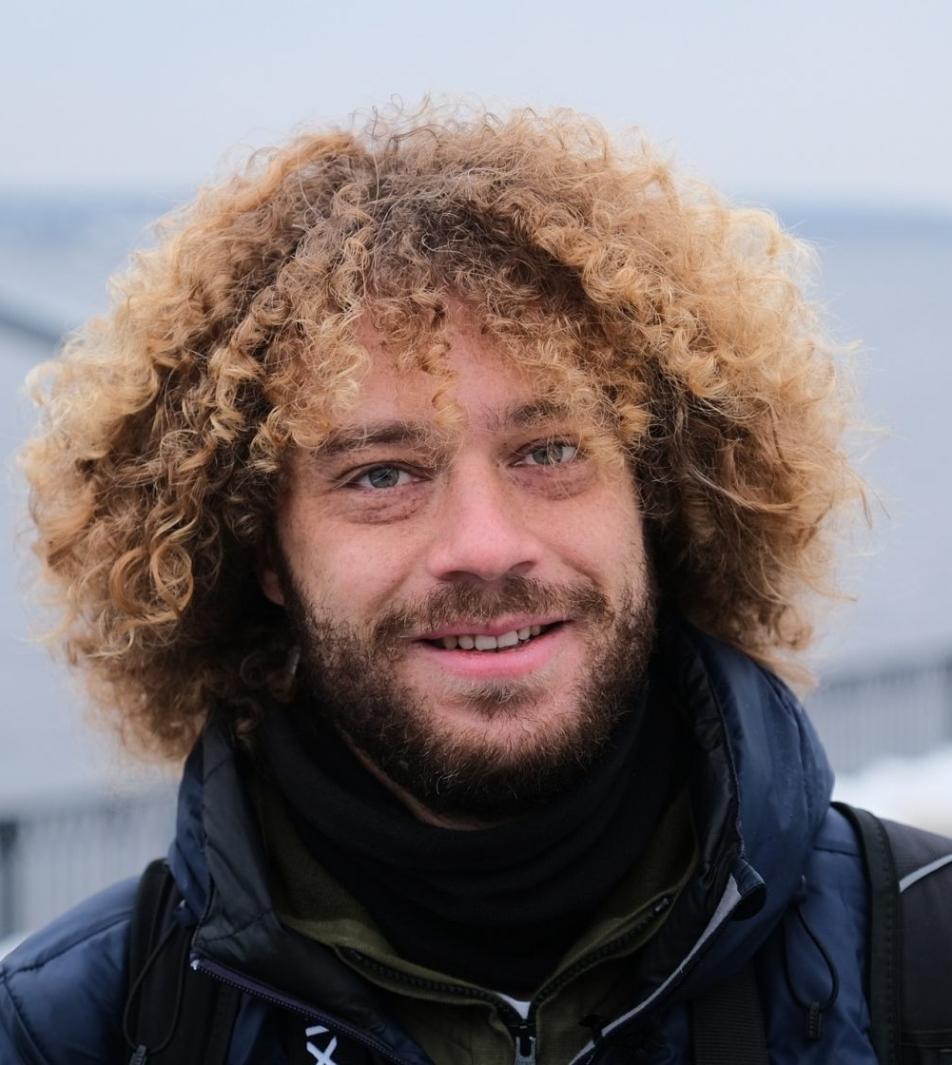



Ilya Varlamov
@varlamov
1.1 million followers
YouTube channel: varlamov
2,34 million followers
https://varlamov.ru

Slide 19
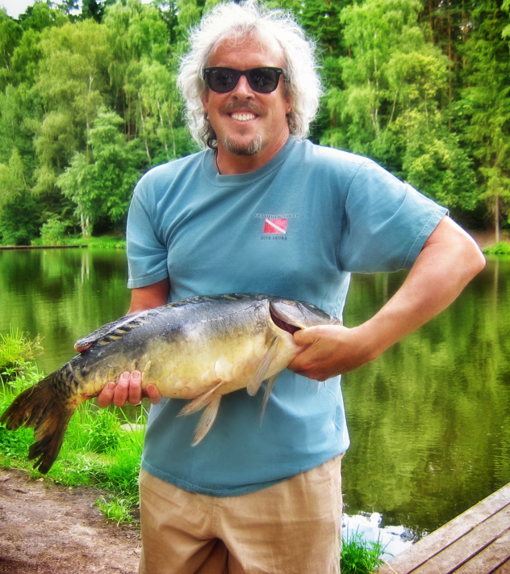
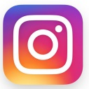
Andrey Makarevich
@smak_am
76.8 thousand followers
YouTube channel "Smak Andrey Makarevich".
206 thousand followers

Slide 20
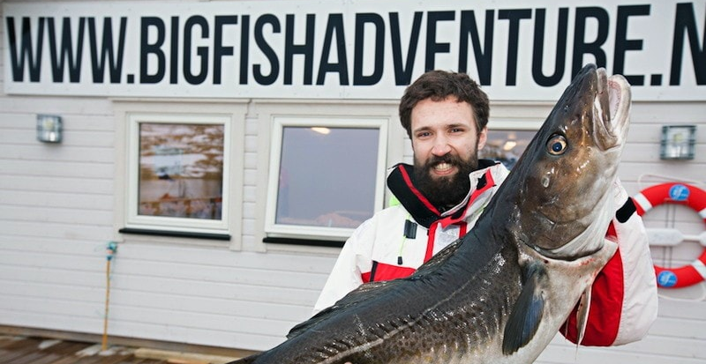
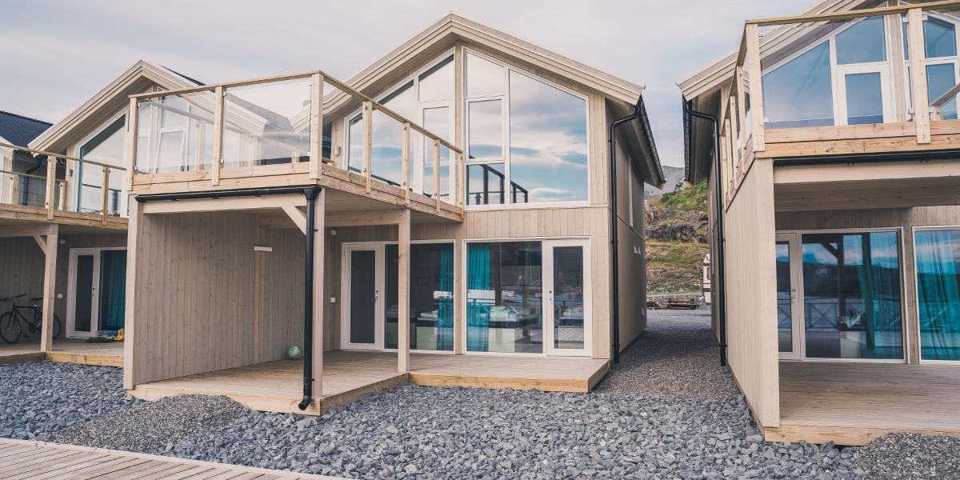
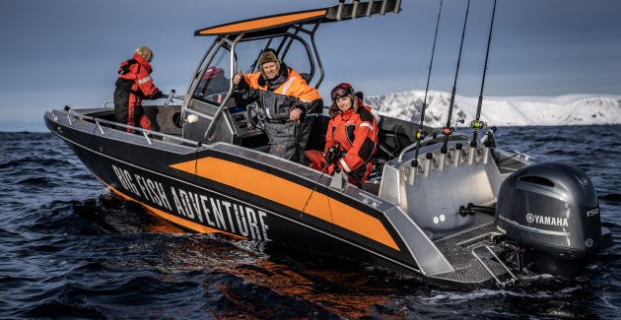
Promotional tour
Duration: 3 days
Departure from Moscow
Entertainment program:
Dating night,
Norwegian fishing,
Cooking master-classes,
Shooting the trip
Trekking
* The cost of air tickets from Moscow to Alta is 500 euros per person.

Slide 21
Risks
spending money without results
seasonality, economic conditions, crises, quarantines and other external factors​
viruses​
fraud

Slide 22
General benefits
attracting new clients from Russia
Increasing the level of company awareness in Russia
popularization of eco-fishing

Slide 23
Thanks for your attention!

