Slide 1
Spor Guiding
Sustainable Cabin
Pavel Avramenko
Pavel Alekseev
Maria Vlasova

Slide 2
Company description
Spor guiding is a family-owned guide company that is located in Langfjordbotn, the heart of the Finnmark alps.
Company offers guided tours in the Finnmark alps with local knowledge and great passion for nature. Other available services: skiing, hiking, sightseeing of nordic nature (panoramic view from yurts).
Current products
and services
Notes:
Husband and wife, Tore & Gro, and their son Vegard live and run the company in Langfjordbotn.

Slide 3
Situation
Problems
Small amount of electricity for Yurts
3 Yurts without electricity, water supply
Heating of the Yurt square and water for Yurt kitchen
Service building (sanitary building) with electricity from main building and water supply
If possible, plan to make the service building also self-sufficient

Slide 4
Solutions
Electricity for Yurts
Heating
Service building
We are planning to use the solar panels to produce electricity
We are planning to use the wood stove for simultaneous heating of the room and water
We are considering the possibility of using solar energy, wind energy and heat pump/boiler. Septic tank or dry toilets for wastewater

Slide 5
Electricity and heating of yurts

Slide 6
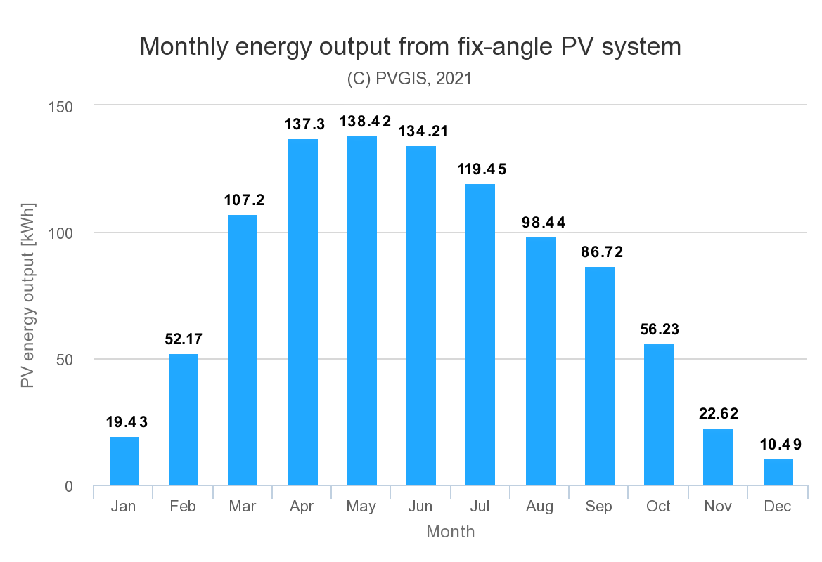
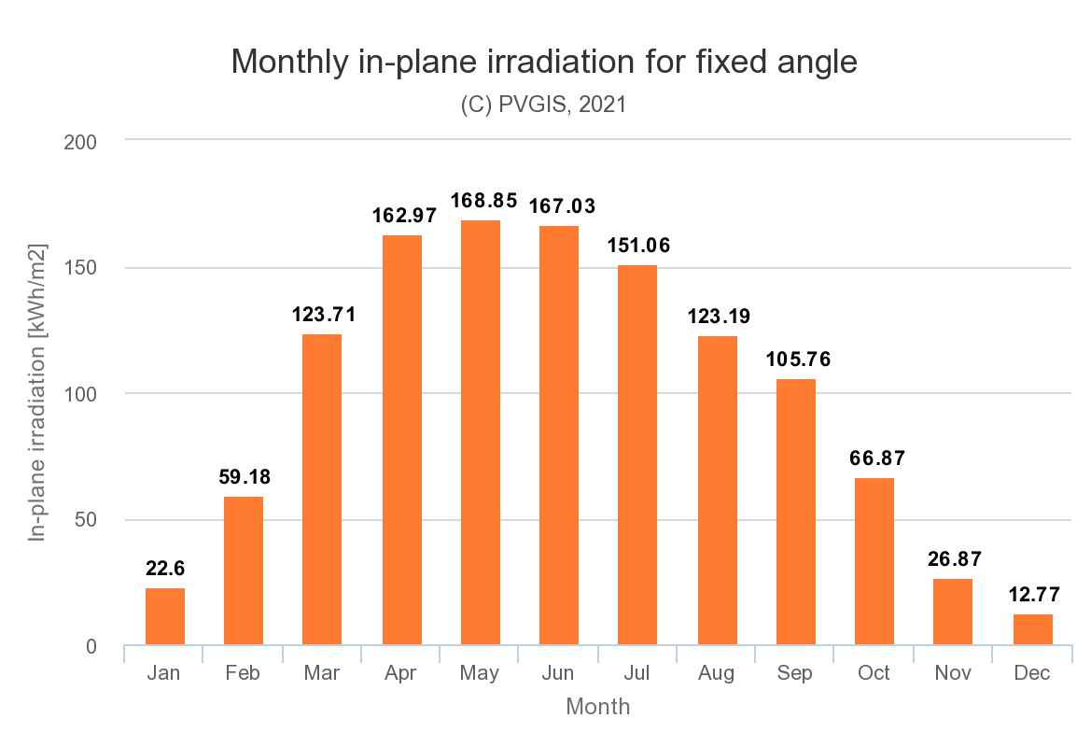
Electricity and heating for yurts
Average family of 3 consumes around 333 kWh per month (no heating)
For the given case, thin-film solar panels might be the best option as they are lightweight. However, they have lower efficiency compared to other solar panels types.
GRAPH 1. Monthly in-plane irradiation for the given case (Norway)

Slide 7
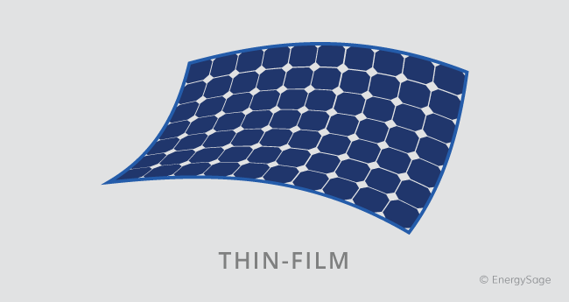
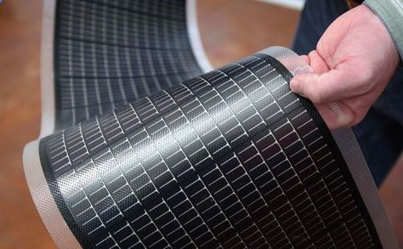
Flexible solar panels
This type of solar panel can cover whole roofs’ area due to its being lightweight and flexible.
Additionally, its price is usually lower than other types of the solar panels and it’s less hard to install it.

Slide 8
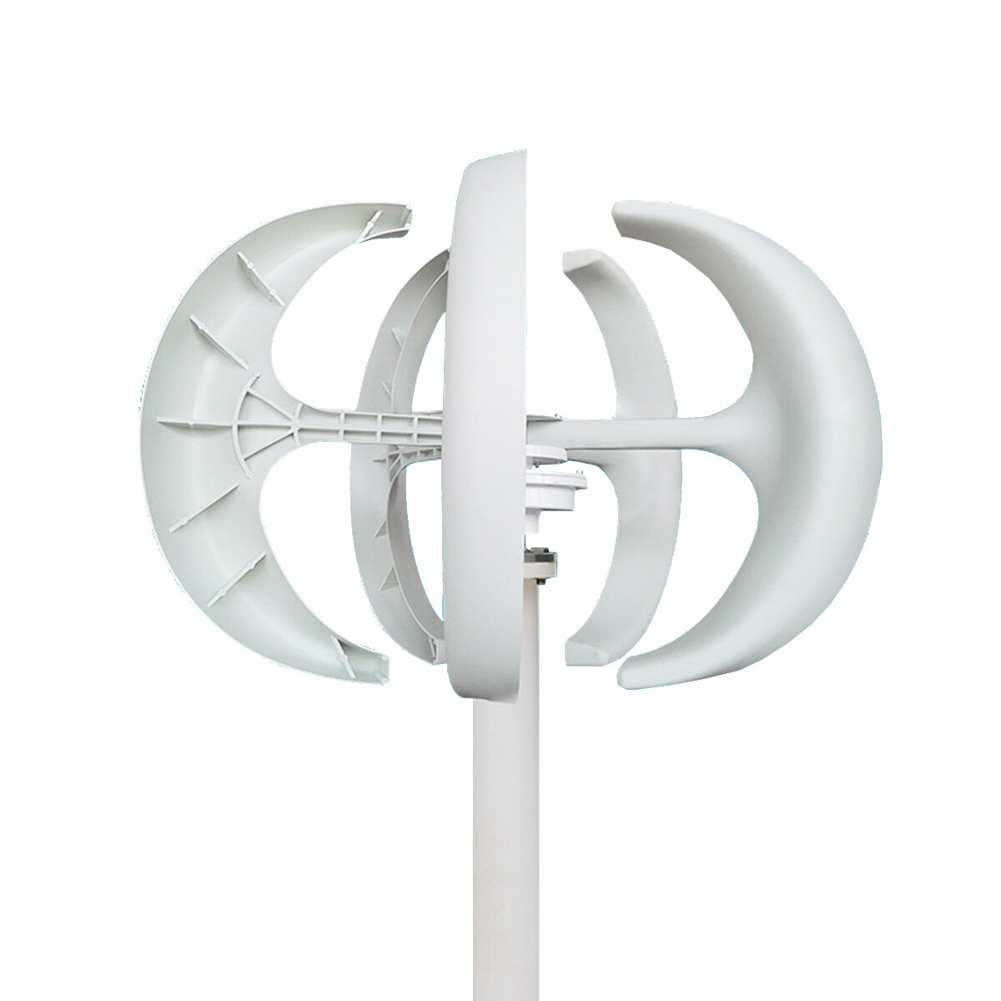
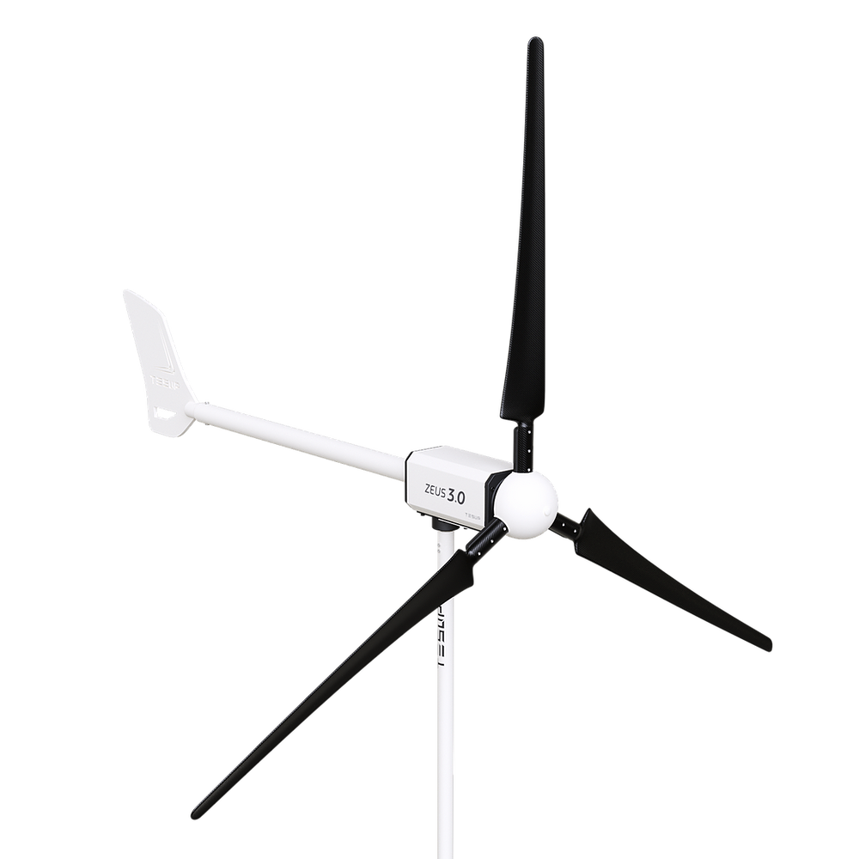
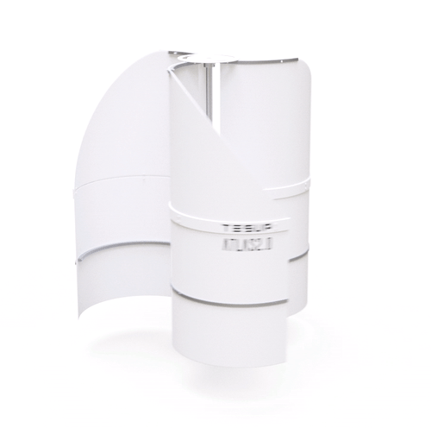
Additional technology for electricity generation
Additionally to solar panels, small-scale on site wind turbines can be used to produce electricity and thus secure its generation during months with lower solar irradiation.
However, this technology use is directly linked to climate and weather conditions.
On site wind turbines with range of 1500W to 3000W electricity production

Slide 9
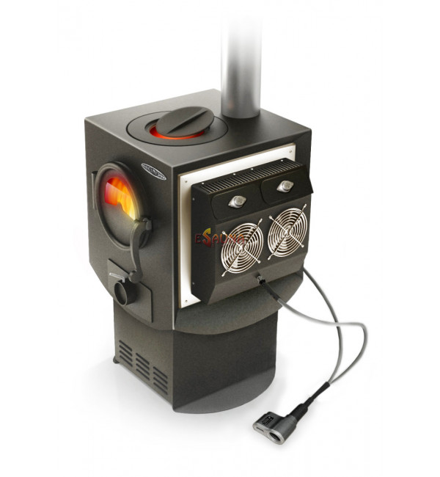
Fire Stove with thermoelectric generator
Thermoelectric generators perform direct conversion of thermal energy into electrical energy. The main element of the generator is a thermoelectric generator module – a semiconductor device located between two electrically insulated and heat-removing plates.
Fire Stove allows to combine heating and generating a small amount of electricity to charge smartphone or lighting

Slide 10
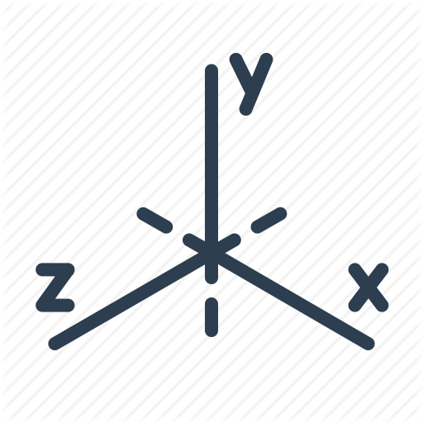

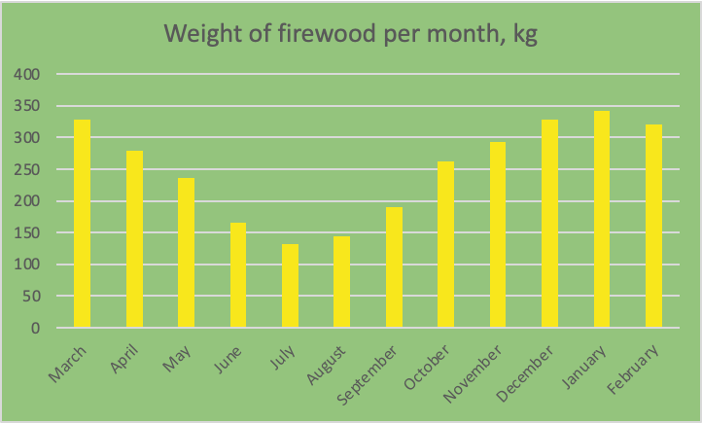




Yurts’ heating: annual firewood consumption
7 KWT/H
3020 KG/Y

Slide 11
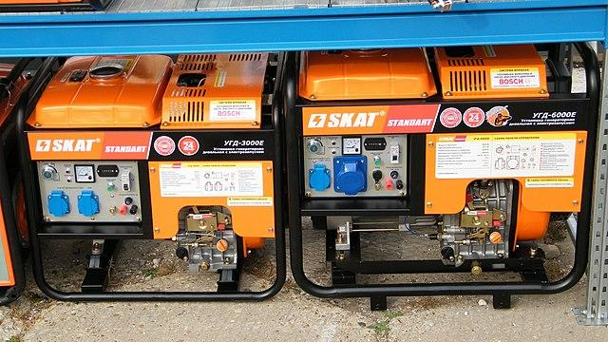
Plan B
In case if something happens or weather won’t be sunny/windy/nice:
Diesel generator
(can be moved around, autonomous, does not depend on any outer conditions; it’s only disadvantage - works on diesel)

Slide 12
Wastewater treatment and waste handling of yurts

Slide 13
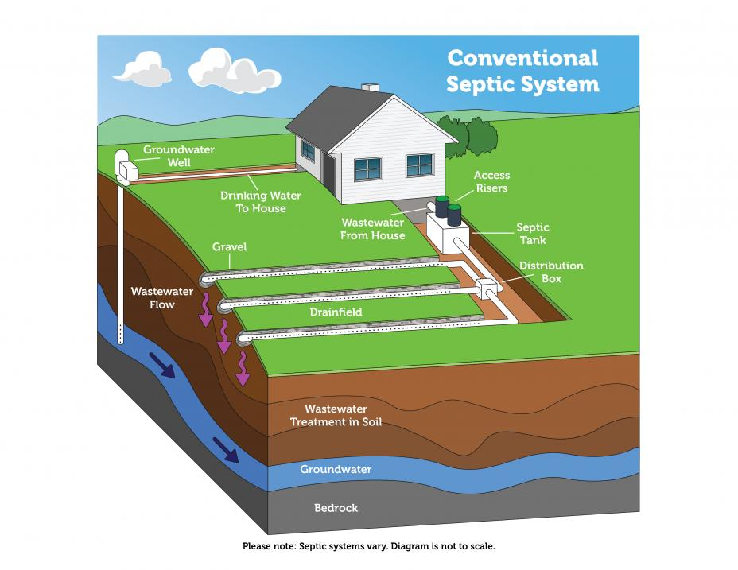
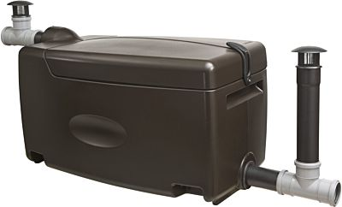
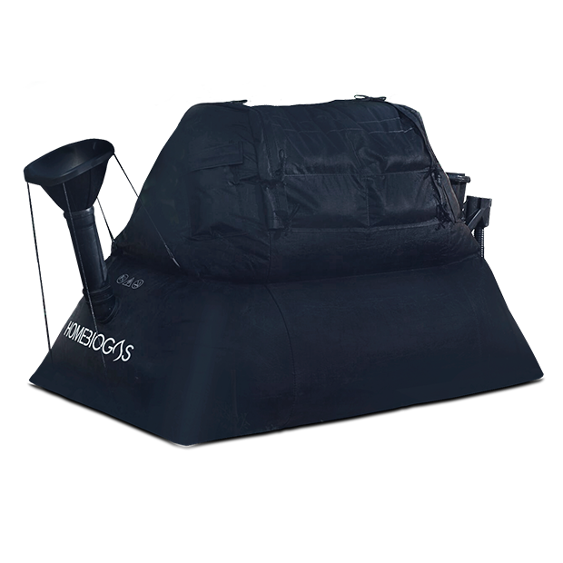
Wastewater
Waste
Septic tank: can be connected to all 3 yurts.
Biomass separation (possibility of production of the biogas)
Separation of other types of the waste (glass, plastics, metal, etc.), providing customers with information regarding proper waste separation, maintaining regular garbage collection (using services of the private company or state regulated company)

Slide 14
Service building: electricity, heating, wastewater

Slide 15
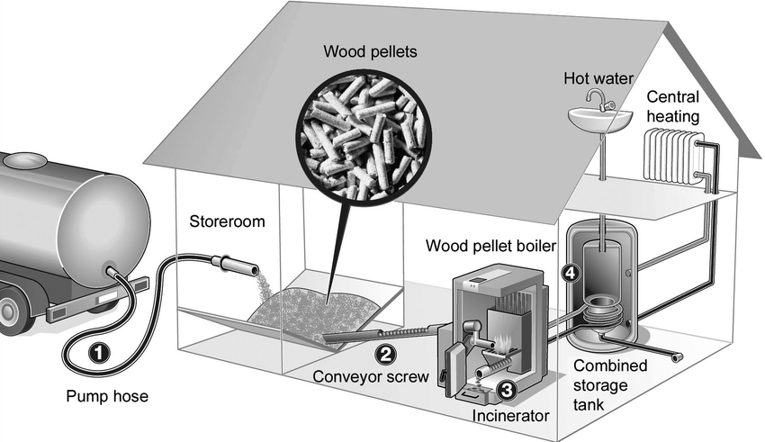
Wood pellet heating can be used to supply energy A major component of these heating systems is the pellet storeroom, airtight room from which the pellets are fed via a conveyor into the furnace located in an adjacent room.
The thermal energy obtained is distributed throughout the building from a heat reservoir. The wood pellets are blown into the storeroom via a pump hose through one or more filling ports.
Wood pellet heating

Slide 16
Wastewater treatment: sanitary building
Possibility to use two different equipments:
SEPTIC
TANK
lower maintenance (can be emptied once in 3-5 years)
can be used for several buildings (for examples yurts+san.build.)
higher system cost including installment and septic tank plus additional equipment
COMPOSTING
TOILET
higher maintenance (should be emptied approximately once a month
relatively lower cost (both installment and equipment)
does not treat any wastewater other than sewage water (thus does not solve the problem with wastewater from yurts)
ST
CT

Slide 17
Thank you!

